Slide 1

Market Trend
Northeastern University - CS5100 Summer 2025
Alexander Gutting, Jaime Espinola, Tsvetelina Hristova, Sinduja Manchi
August 12th, 2025
Notes:
Inna

Slide 2
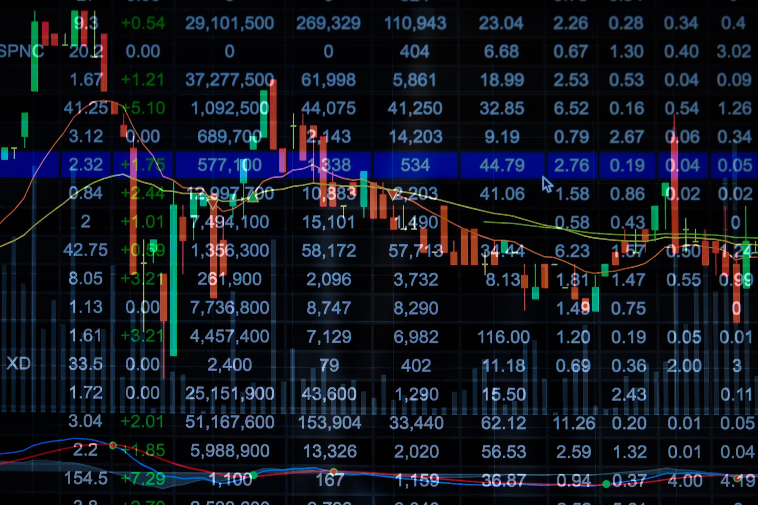
Introduction
Northeastern University - CS5100 Summer 2025
Problem Statement
Develop a model to predict stock market trends using historical stock prices and related data, aiming to identify patterns that can guide investment decisions for companies that follow the S&P 500 index
Motivation and Goals
Build a regression model to predict future prices of select S&P 500 stocks
Notes:
Inna

Slide 3
Thought Process
Northeastern University - CS5100 Summer 2025
Data preprocessing (cleaning, encoding)
Linear Regression
Evaluation metrics: MSE, MAE, R²
Visualizations: scatter plot, residuals, distribution plot
Notes:
Sindu

Slide 4
Dataset Info
Northeastern University - CS5100 Summer 2025
S&P 500 Stock Data dataset from Kaggle:
Historical 5 year daily stock prices for all companies following the S&P 500 Index
FileName: all_stocks_5yr.csv
Columns: Date, Open, High, Low, Close, Volume, Name
Size: 7 Columns, 619040 rows
Notes:
Sindu
Explain what each column data means. Date
Open: Price in USD of the stock at market open
High: Highest price of the stock on the given date
Low Close: Lowest price of the stock on the given date
Volume: Number of shares that were traded of the stock on the given date
Name: Ticker identifier of the stock

Slide 5
Code Summary
Dataset: Downloads and loads 5-year S&P 500 stock data.
Libraries Used: pandas, numpy, scikit-learn, matplotlib, seaborn.
Preprocessing:
Extract and Explores CSV data
Encodes categorical variables
Modeling:
Splits data into training and test sets.
Uses Linear Regression to predict stock prices.
Evaluation:
Measures accuracy with Mean Squared Error, MAE, and R² Score.
Visualization:
Plots actual vs predicted prices for analysis
Notes:
Alex

Slide 6
Conclusions
Northeastern University - CS5100 Summer 2025
Achievements:
Successful stock prediction using linear regression
Strong evaluation metrics
Visual comparison of predictions vs actual data
Lessons Learned:
Data preprocessing is crucial
Linear regression is simple but limited
Notes:
Jaime

Slide 7
THANK YOU
Questions?
Northeastern University - CS5100 Summer 2025

